Slide 1
Primary Visual Cortex Double-photon imaging data mining report
Wang Binxu
Louis Tao Lab
2017.7
(minor modified 2017.12)

Slide 2
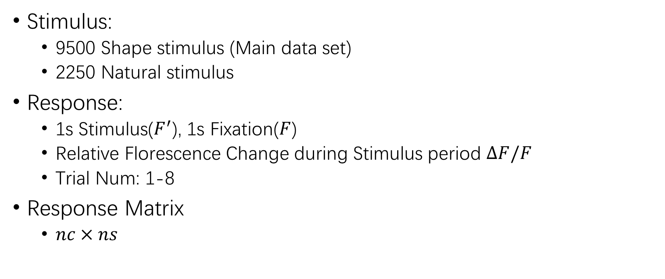
Data Structure
Stimulus:
9500 Shape stimulus (Main data set)
2250 Natural stimulus
Response:
1s Stimulus($F^{′}$), 1s Fixation($F$)
Relative Florescence Change during Stimulus period $ΔF/F$
Trial Num: 1-8
Response Matrix
$nc×ns$

Slide 3
Stimulus Structure
5 translation
8/16 rotation

Slide 4
Contents: Sort by Analysis method
Single cell processing
Tuning Curve Fitting:
Single Neuron Orientation Selectivity
Position Selectivity
Population processing
NMF (Non-Negative Matrix Factorization): Feature Searching
MLP (Multi-Layer Perceptron): Classifier
Discriminating neural code of Different shape
Explore the Similarity and Difference in Neural Code
LLE (Local Linear Embedding): Dimension Reduction
Finding Geometrical/Topological Structure in High-Dim Space

Slide 5
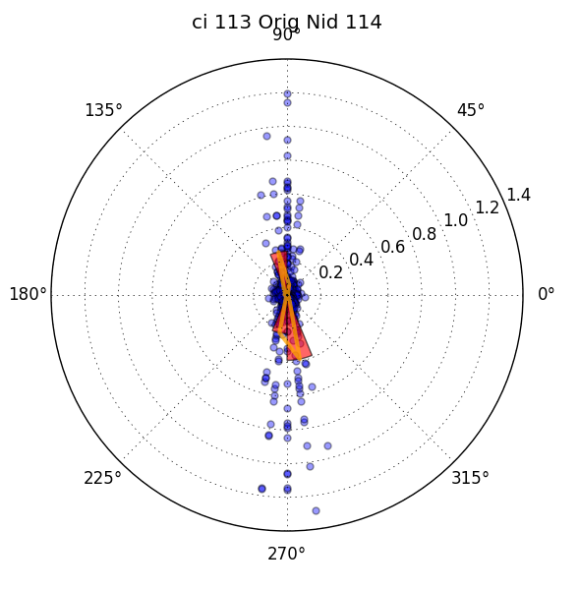
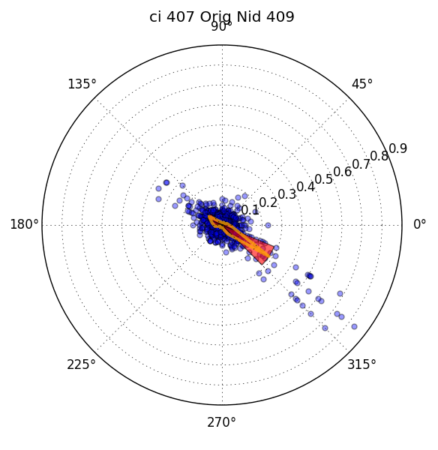
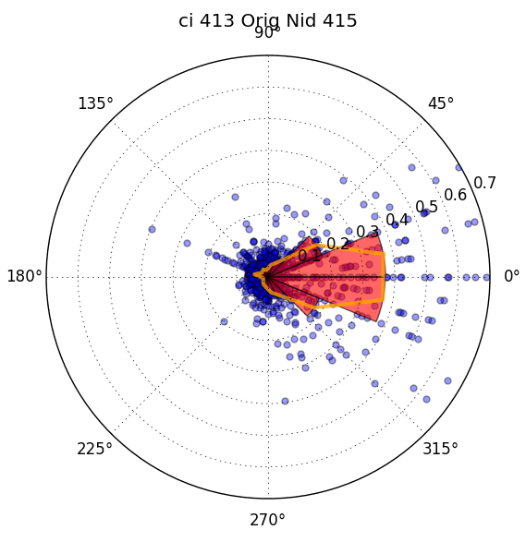
Orientation Tuning Behavior
Simple Single tuning orientation neuron
Notes:
Scatter response to $θ$ angle stimulus on a polar plot.
Averaging response in each bin. And fit the averaging histogram curve (orange line)

Slide 6
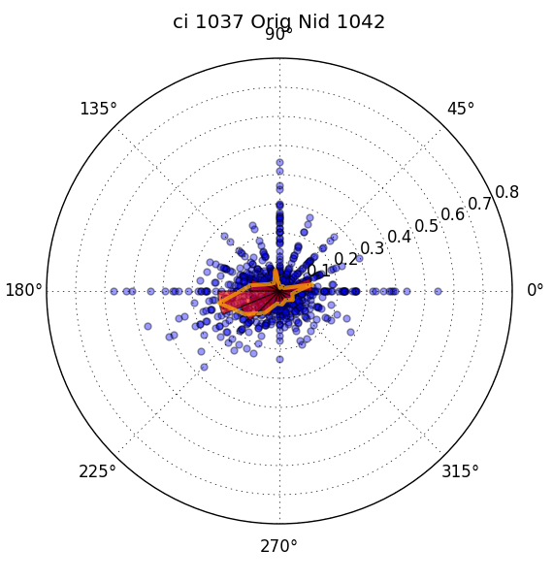
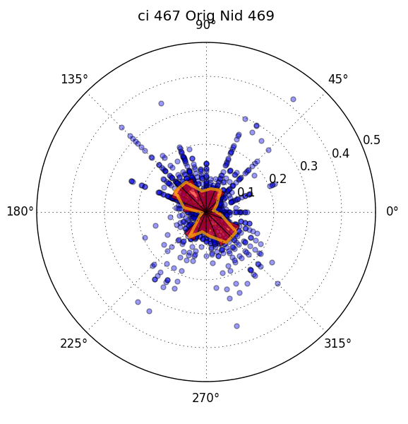
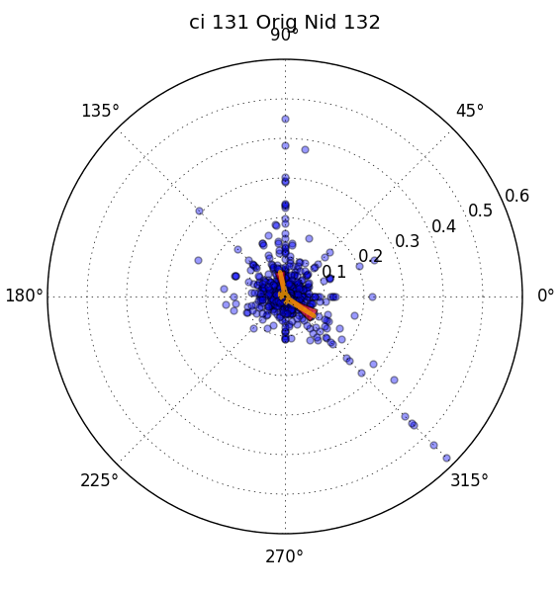
Orientation Tuning Behavior
Other Tuning Behavior: Multi-peak, Wide-peak

Slide 7
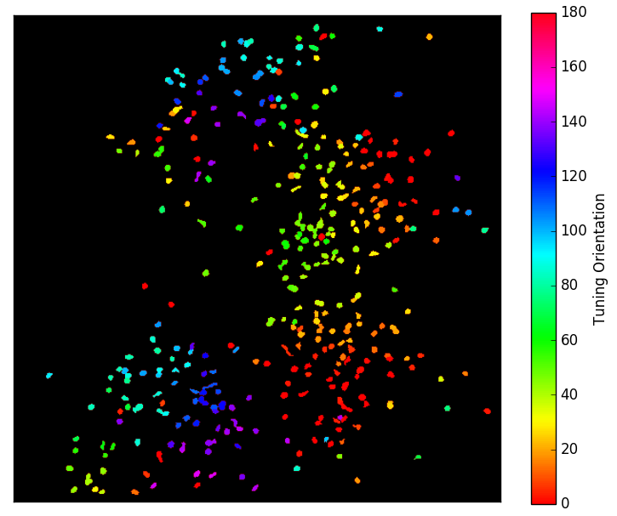
Orientation Map
Notes:
Use Basic fitting line shape to fit all neurons’ Tuning behavior
Well fitting criterion
282 valid neurons

Slide 8
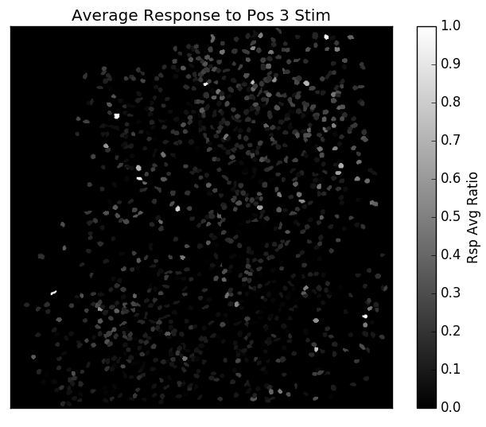
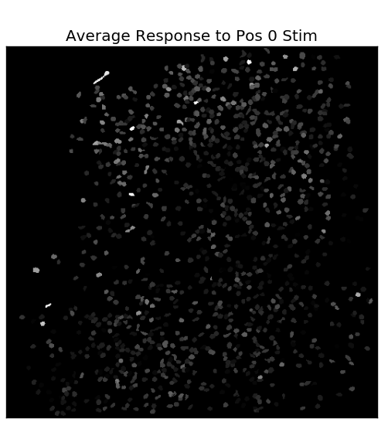
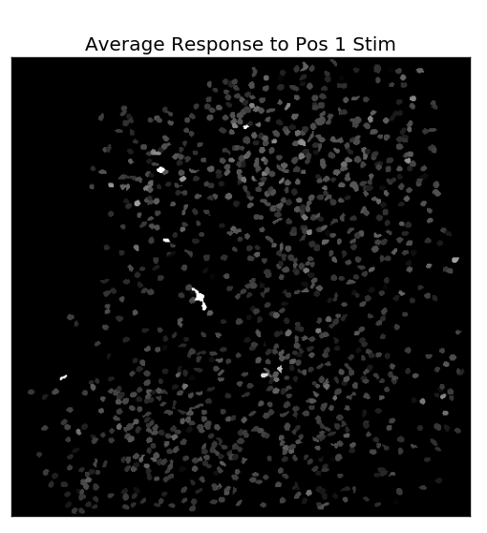
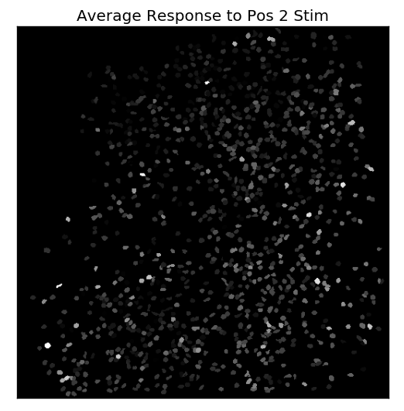
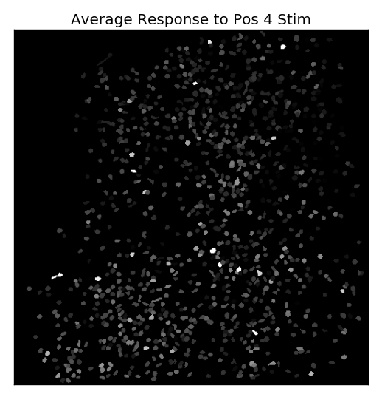
Position Selection
Notes:
Plot Normalized Average Response to
Better Way to illustrate Position Selection?

Slide 9
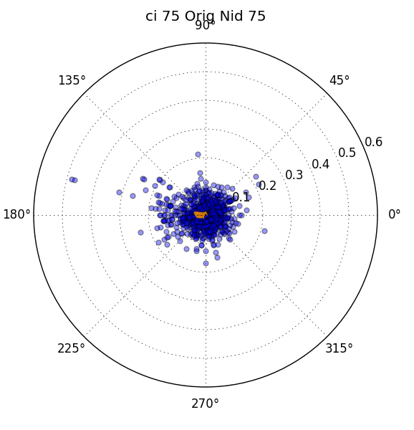
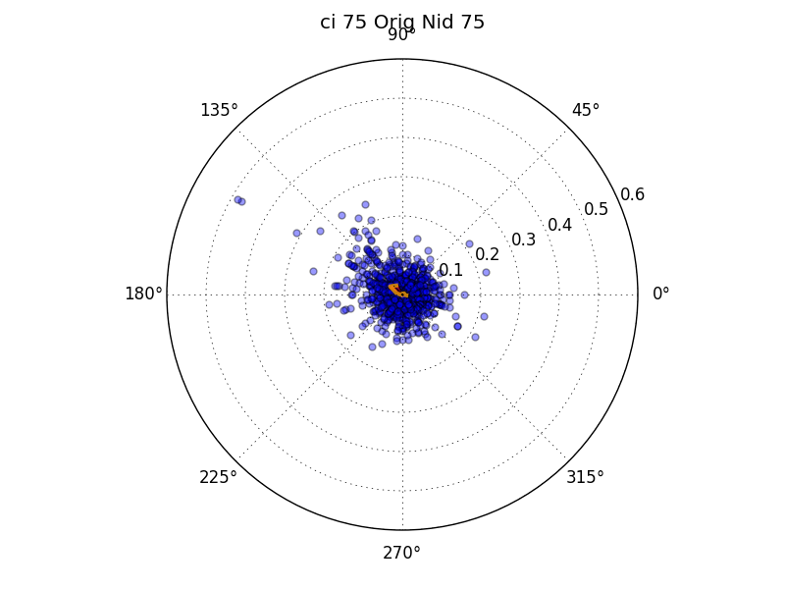
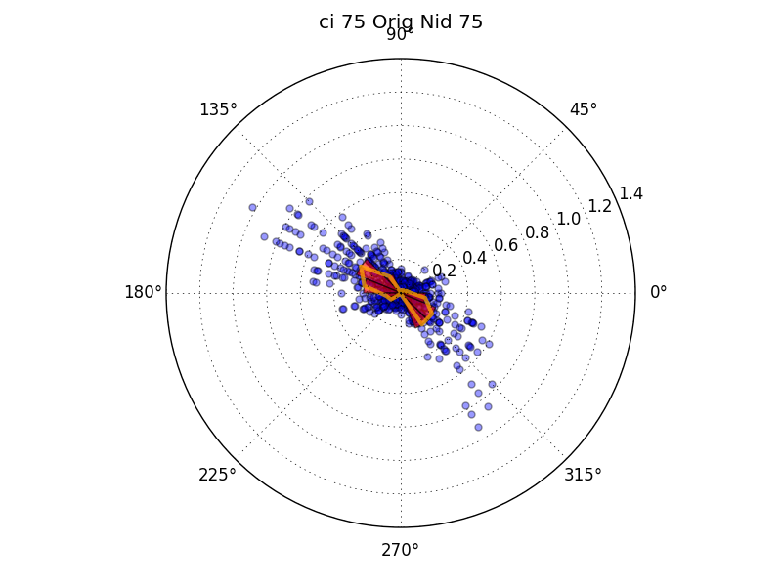
Edge Tuning
Edge Tuning(Semi-circle & Triangle & sector),
Non-Equivalence of 2 edge
Tuning behavior diff from Orient: e.g. 75 Strong tune vs no tune
Response to Begin edge / End edge of Solid shape
Response to Single Orientation Ray
Notes:
Left: tune to first

Slide 10
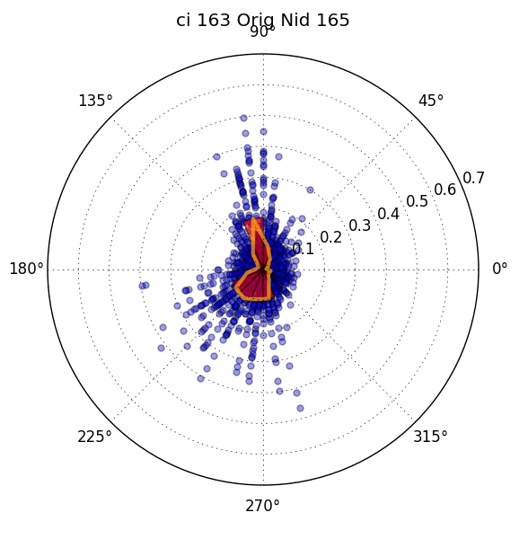
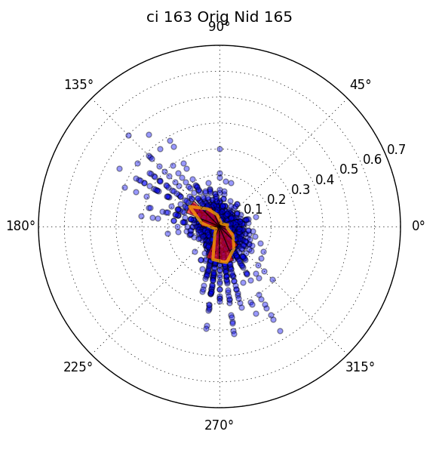
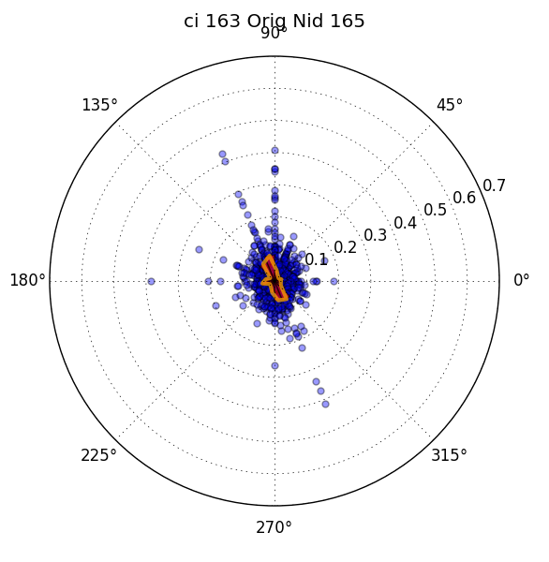
Edge Tuning
Response to Begin edge / End edge of Solid shape
Response to Single Orientation Ray

Slide 11
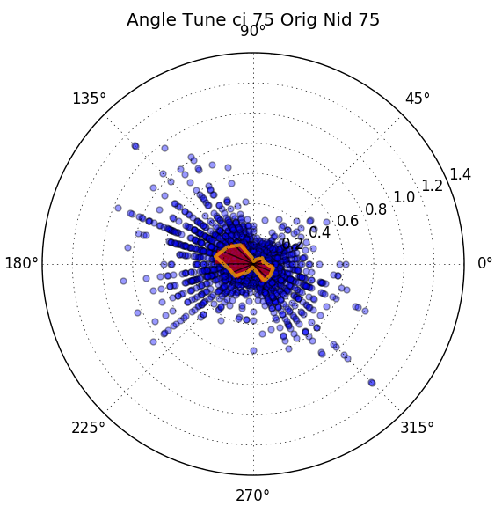
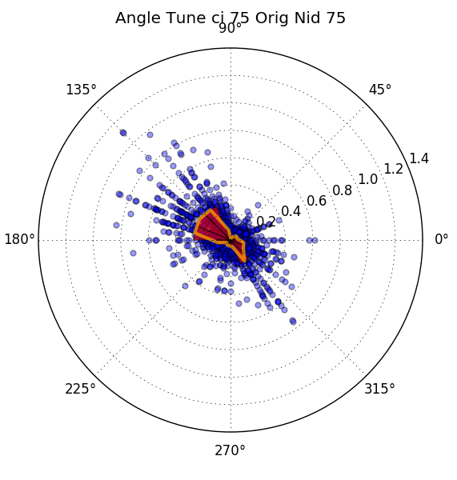
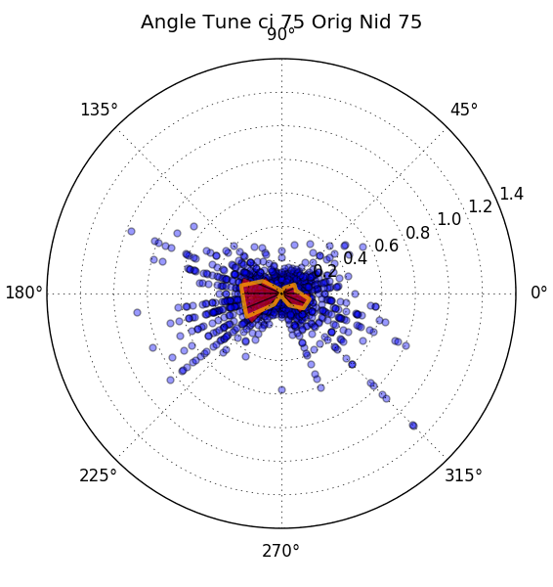
Angle Tuning Neuron
Pool Data, Theta1 scatter, theta2 scatter

Slide 12
Population Processing
What we might get beyond single neuron tuning curve?

Slide 13
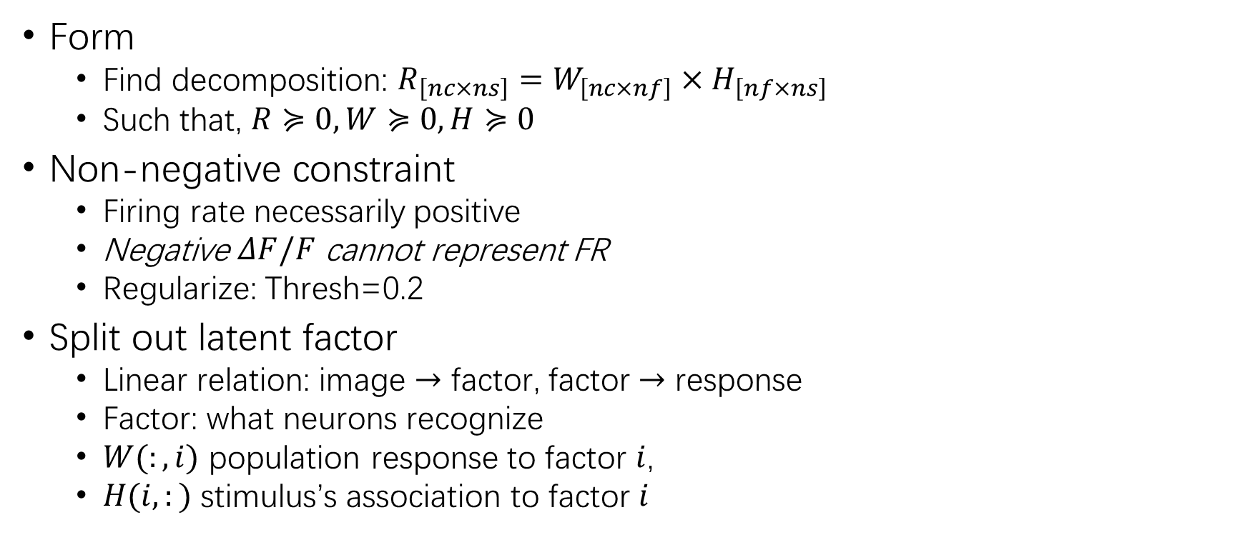
Rationale of NMF:
Form
Find decomposition: $R_{\left[nc×ns\right]}=W_{\left[nc×nf\right]}×H_{\left[nf×ns\right]}$
Such that, $R≽0, W≽0,H≽0$
Non-negative constraint
Firing rate necessarily positive
Negative $ΔF/F$ cannot represent FR
Regularize: Thresh=0.2
Split out latent factor
Linear relation: image $→$ factor, factor $→$ response
Factor: what neurons recognize
$W(:,i)$ population response to factor $i$,
$H(i,:)$ stimulus’s association to factor $i$

Slide 14
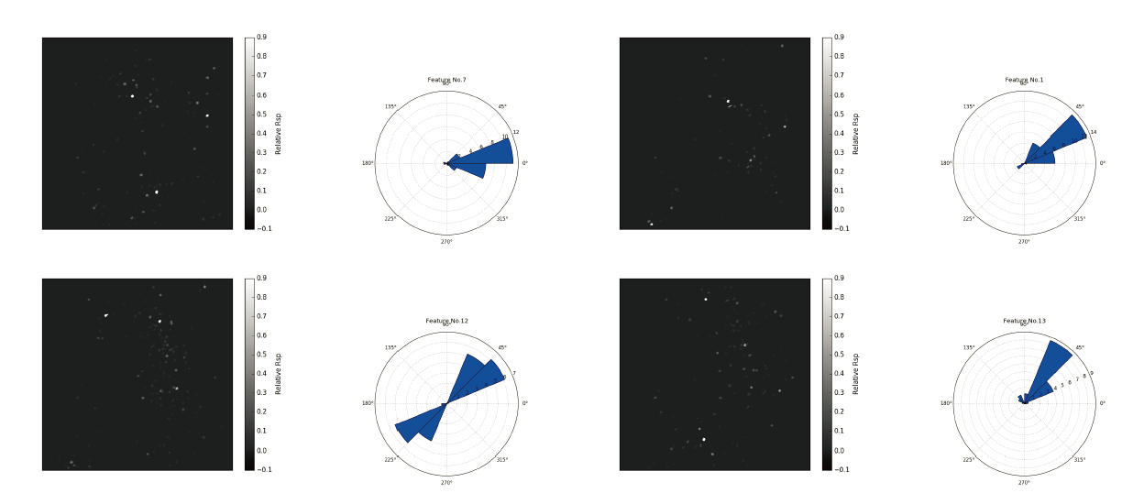
NMF of Ray stimulus
Orientation Tuning Dominated
Single Tuning Direction vs Double Tuning Direction
Notes:
Visualize $W\left(:,i\right)$ : plot response strength on physical cortical space
Visualize $H\left(i,:\right)$ : Weighted histogram the stimulus’s orientation parameter on polar plot,
详情参见 Report PDF

Slide 15
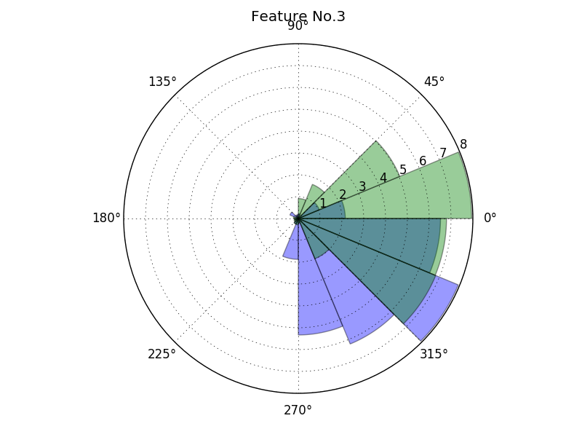
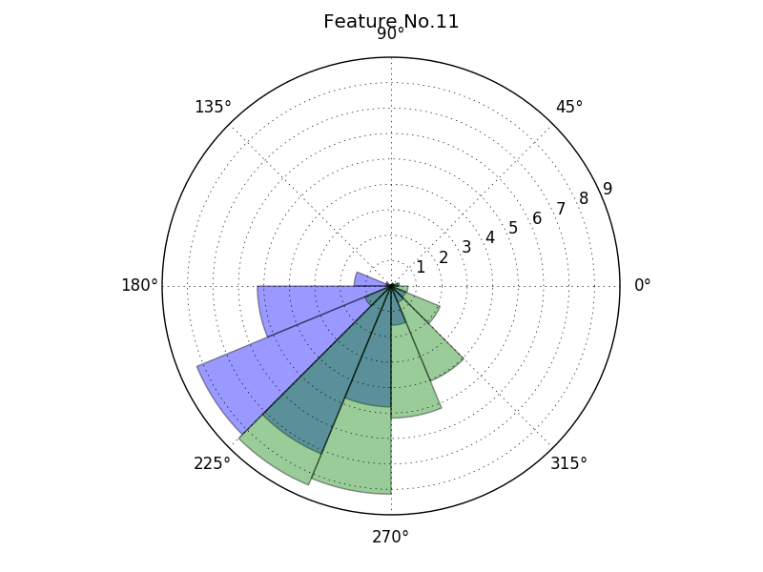
NMF of Angle stimulus
Most features tune to single edge of border angle
Border lines are equivalent

Slide 16
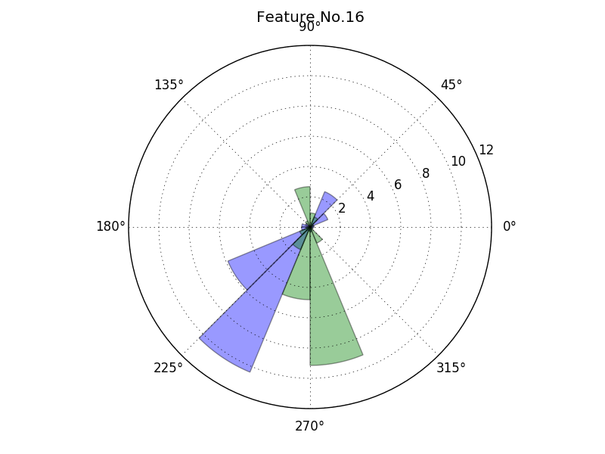
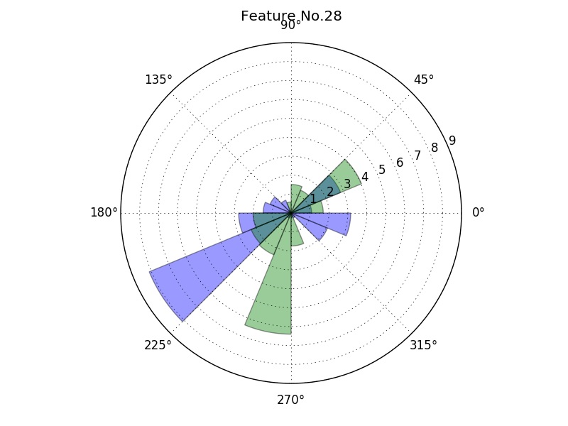
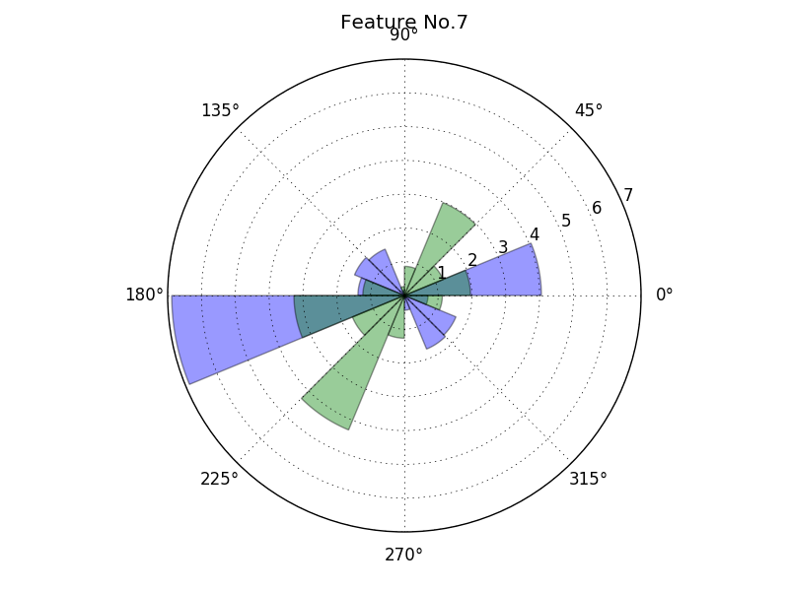
NMF of Angle stimulus
Few Angle Tuning feature

Slide 17
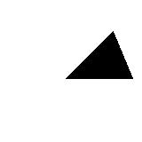
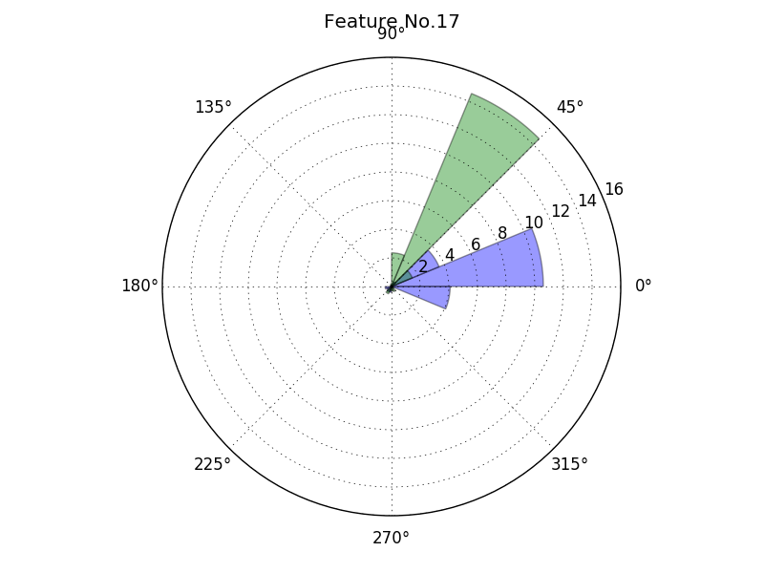
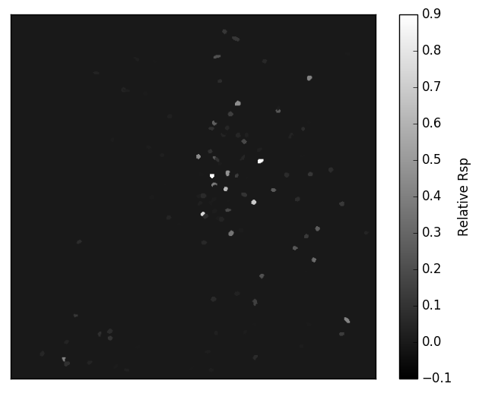
NMF of Triangle stimulus
Most Features are Solid Angle Selective:
Two edge are not equivalent!
Receptive field of simple cell construct this
Notes:
Green and Blue Histogram denotes weighted histogram of $θ1$and $θ_{2}$ parameter of solid angle stimulus

Slide 18
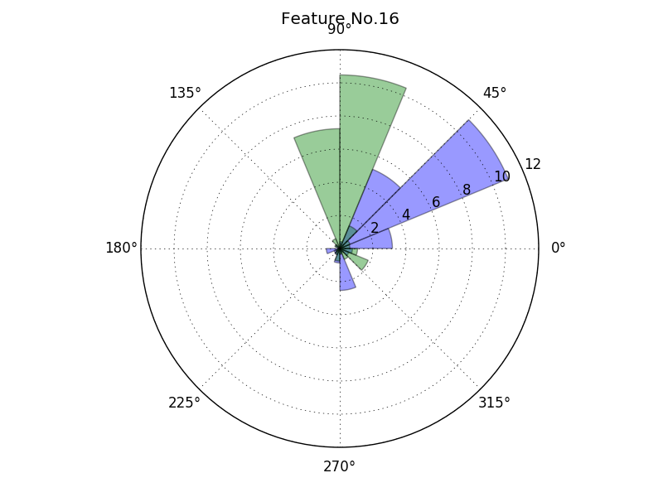
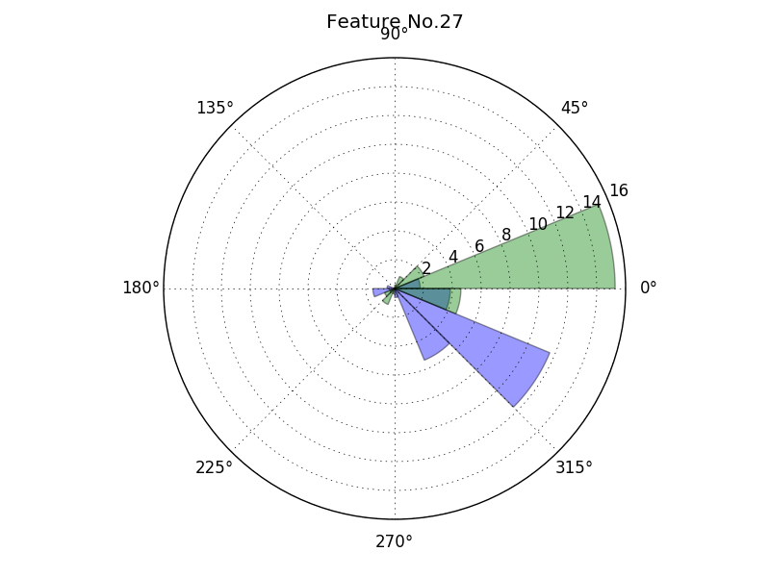
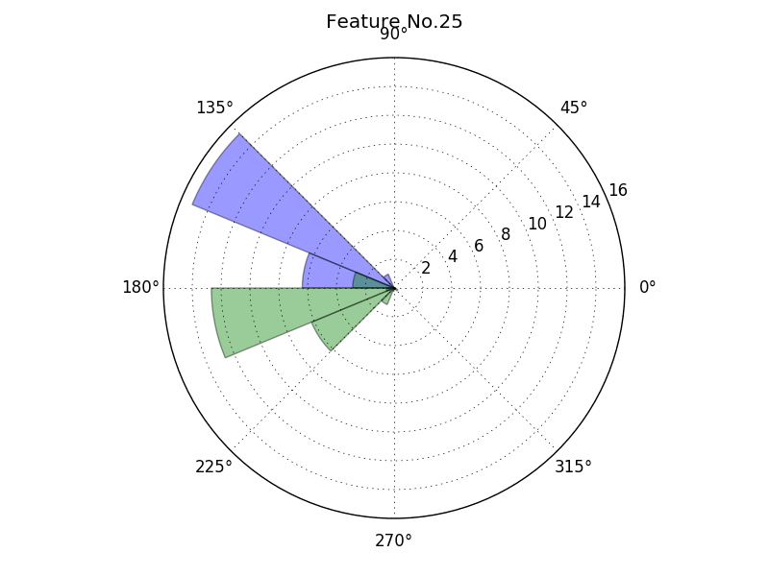
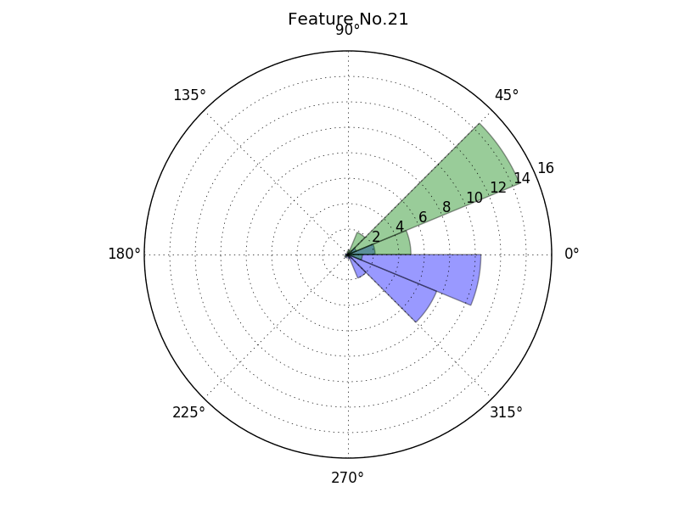
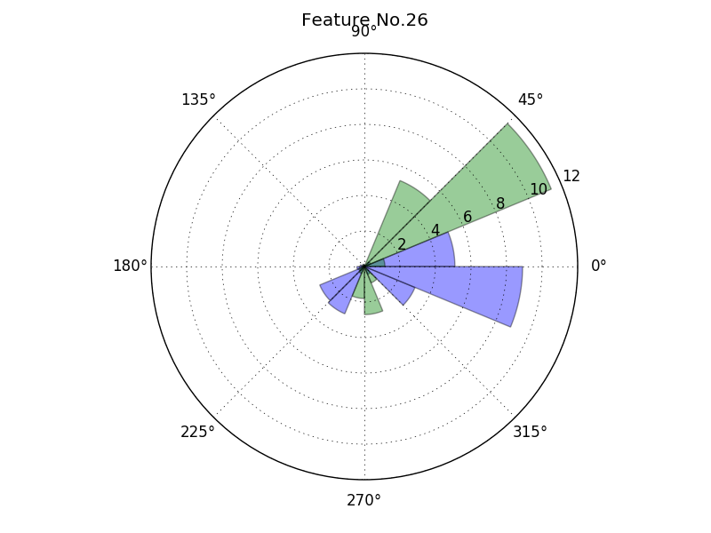
NMF of Triangle stimulus

Slide 19
Inspiration
NMF features reveal different coding structure of Triangle and Border angle stimulus!
Corresponding Border and Triangle spatial patterns are similar
Support by that neurons have different tuning behavior to Edge and line

Slide 20
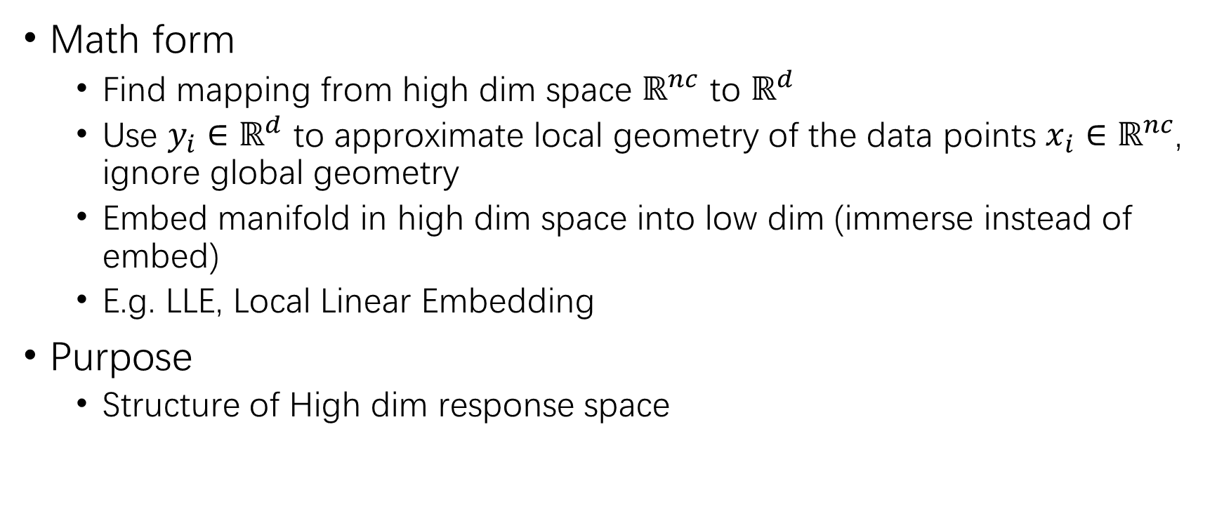
Nonlinear Dimension Reduction
Math form
Find mapping from high dim space $ℝ^{nc}$ to $ℝ^{d}$
Use $y_{i}∈ℝ^{d}$ to approximate local geometry of the data points $x_{i}∈ℝ^{nc}$, ignore global geometry
Embed manifold in high dim space into low dim (immerse instead of embed)
E.g. LLE, Local Linear Embedding
Purpose
Structure of High dim response space

Slide 21
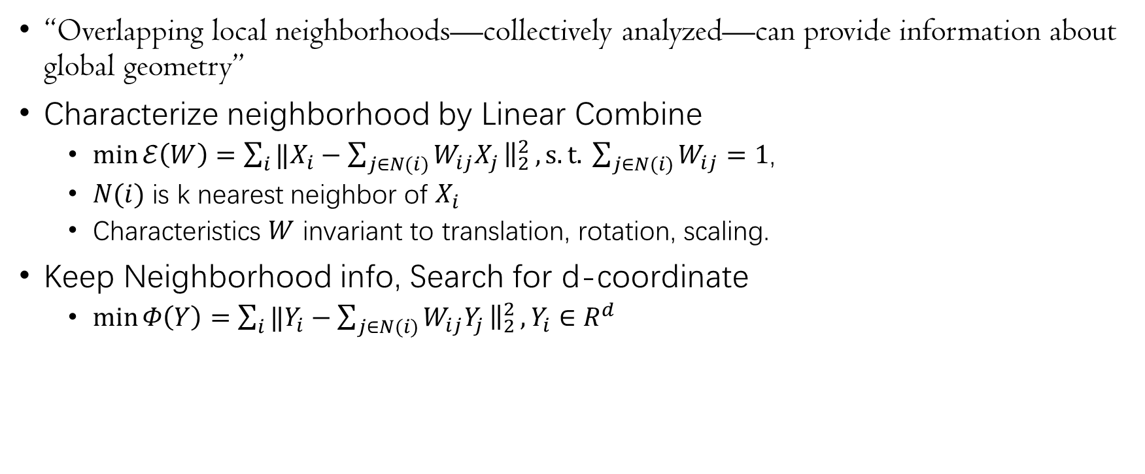
LLE(Local Linear Embedding)
“Overlapping local neighborhoods—collectively analyzed—can provide information about global geometry”
Characterize neighborhood by Linear Combine
$\min{ℰ\left(W\right)=\sum_{i}{{‖X_{i}−\sum_{j∈N(i)}{W_{ij}X_{j}}\left.​\right\|}_{2}^{2}}}, s.t. \sum_{j∈N(i)}{W_{ij}}=1$,
$N(i)$ is k nearest neighbor of $X_{i}$
Characteristics $W$ invariant to translation, rotation, scaling.
Keep Neighborhood info, Search for d-coordinate
$\min{Φ\left(Y\right)=\sum_{i}{{‖Y_{i}−\sum_{j∈N(i)}{W_{ij}Y_{j}}\left.​\right\|}_{2}^{2}}}, Y_{i}∈R^{d}$
Roweis S T, Saul L K. Nonlinear dimensionality reduction by locally linear embedding[J]. science, 2000, 290(5500): 2323-2326.

Slide 22
LLE for Finding embedding manifold
There is latent manifold!
Latent manifold of figure, word vector…
Relation to Neuroscience
Manifold in population response vector?
Manifold for tuning curve?
If latent topology is more exotic？
If sampling is not enough？
Notes:
宇秀的tuning curve的
需要注意 流形学习 nonlinear method 有一个问题是由于其本身的Point就是

Slide 23
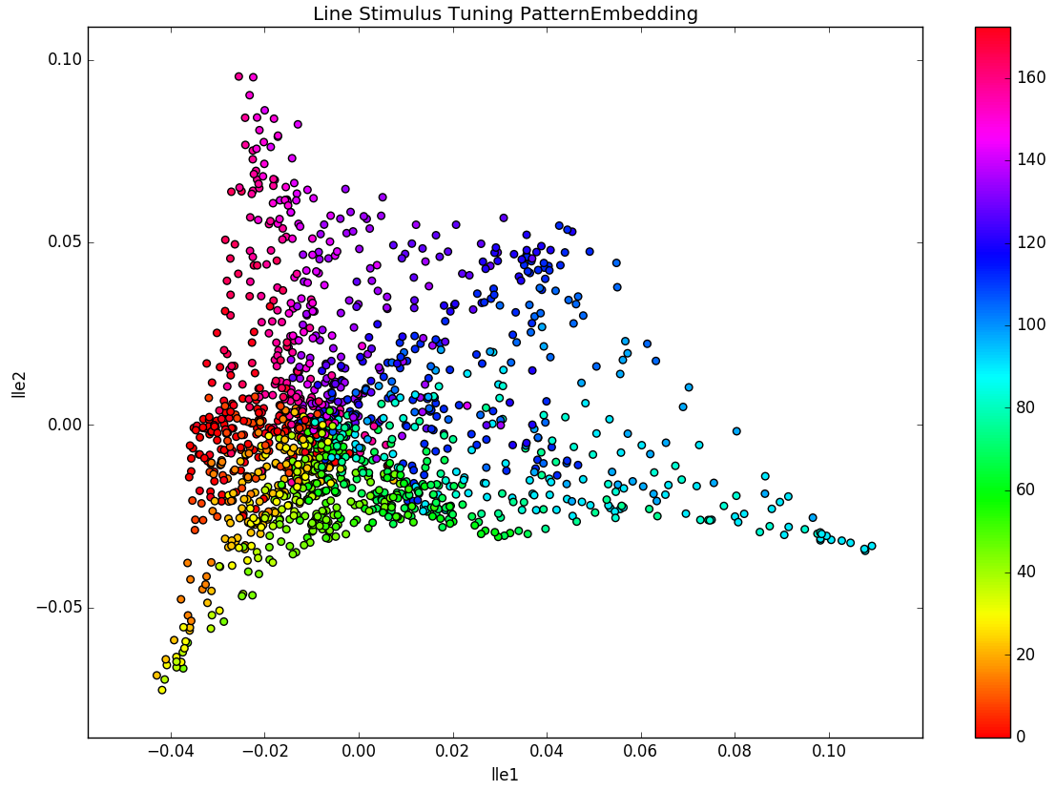
Ray Stimulus Response Embedding
Cyclic Structure Preserved

Slide 24
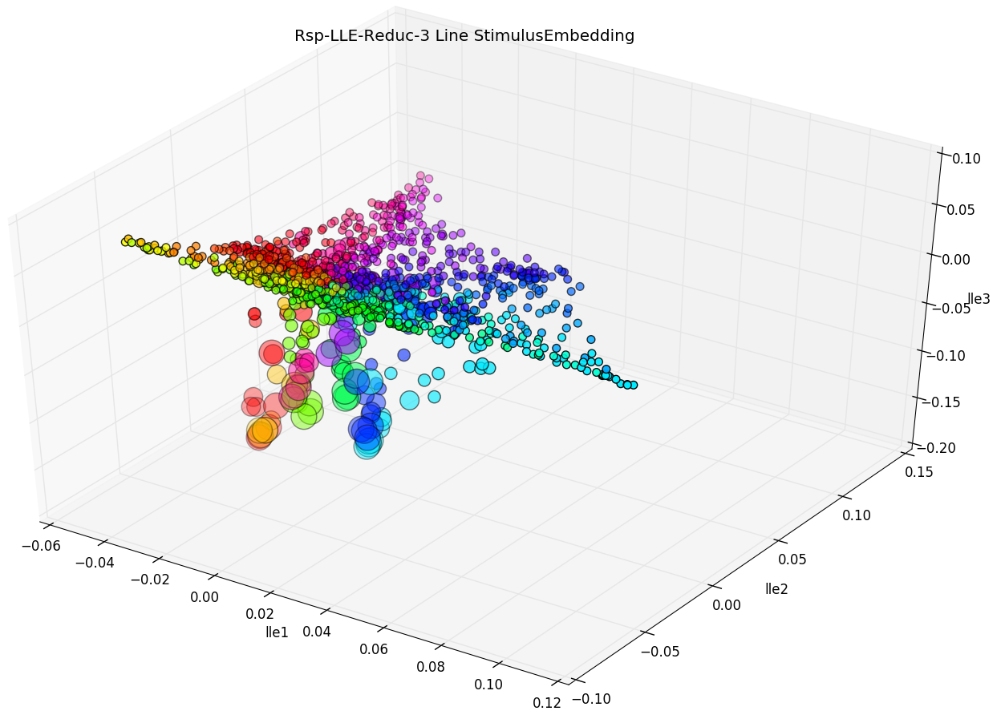
Ray Stimulus Response Embedding-Width
Width Coding and Orientation Coding disentangled

Slide 25
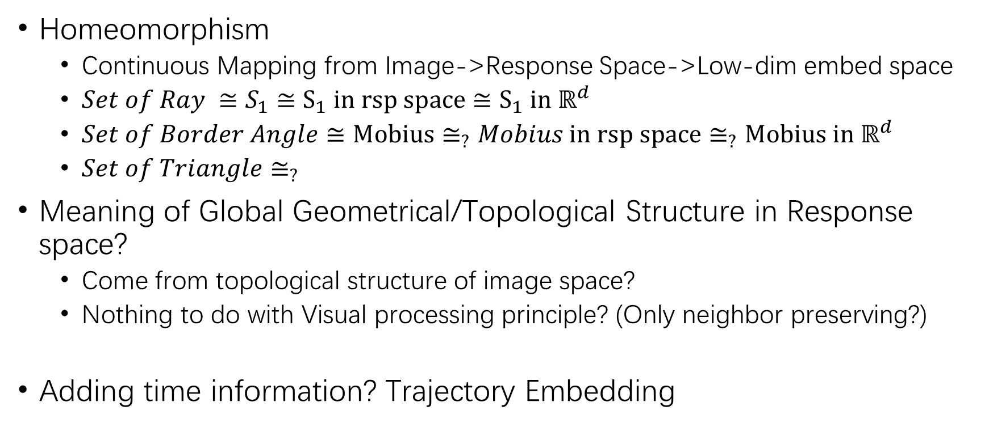
Digression: Topological Consideration
Homeomorphism
Continuous Mapping from Image->Response Space->Low-dim embed space
$Set of Ray ≅S_{1}≅S_{1} in rsp space≅S_{1} in ℝ^{d}$
$Set of Border Angle≅Mobius≅_{?}Mobius in rsp space≅_{?}Mobius in ℝ^{d}$
$Set of Triangle≅_{?}$
Meaning of Global Geometrical/Topological Structure in Response space?
Come from topological structure of image space?
Nothing to do with Visual processing principle? (Only neighbor preserving?)
Adding time information? Trajectory Embedding
Notes:
Projective Plane

Slide 26
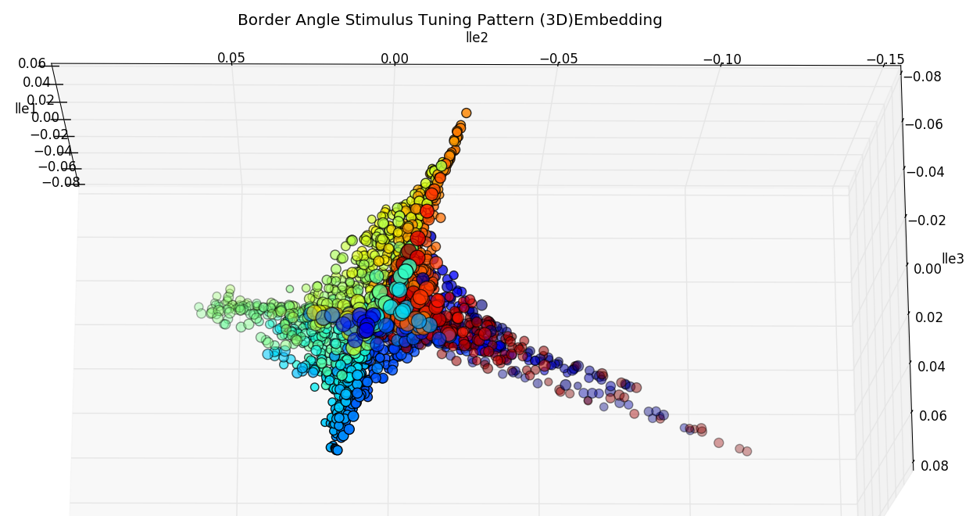
Mobius Strip in High-Dim space?

Slide 27

Classifier
Manually add label to stimulus
Shape…
Use label to train a classifier mapping Response vector to label
$ℝ^{nc}→label set$
Partition of Response space $ℝ^{nc}$

Slide 28
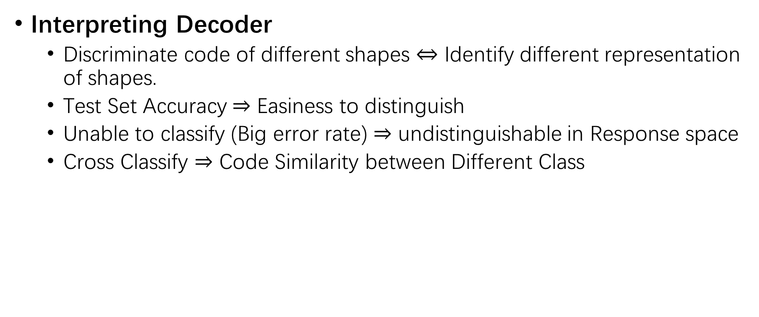
Classification : Shape decoding
Interpreting Decoder
Discriminate code of different shapes $⇔$ Identify different representation of shapes.
Test Set Accuracy $⇒$ Easiness to distinguish
Unable to classify (Big error rate) $⇒$ undistinguishable in Response space
Cross Classify $⇒$ Code Similarity between Different Class

Slide 29
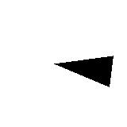
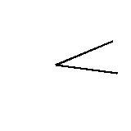

Triangle, Border angle, Sector Classifier

Slide 30
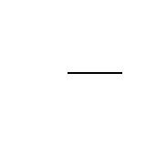
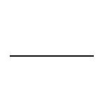

Border Angle, Line, Curve

Slide 31
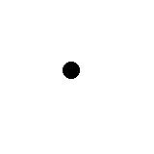
Border Angle, Line, Dot, Triangle

Slide 32









Cross Classify
Notes:
Classify Untrained Unseen Stimulus’s Rsp into trained classes:
To see to the representation of which, the new Stim’s code resemble most.

Slide 33
Inspiration
Code of Solid and Border figure can be easily distinguished
Different Neuron tune to B-W edge / line
Second Order shape
Eyebrow has 1st order shape as lines, 2nd order shape as curve

Slide 34
Questions we can ask
Coding difference between Solid angle and Border angle; Edge of solid and line?
Coding of Multi-orientation stimulus (especially angle)?
Interaction between Different Orientation Response?

Slide 35
Methods to try
“Population level method” has not yet provided insight into population coding!
Encoding and Decoding
More sophisticated NN encoding (fitting) model.
CNN decoding model

Slide 36
Question about Variability
Trial variability? And correlation between trial variabilities
Is it related to some kind of information?

Slide 37
Deep Learning

